Slide 1


Latent Class Analysis
Another way of examining interrelationships

Slide 2
Install LCA for SPSS
Extensions → Extension Hub → search ‘latent’ install STATS_LATENT_CLASS
It is available under ‘Analyze’ → Loglinear → Latent Class Analysis
If you have version 27 or less you need to follow alternative instructions ☹

Slide 3
Categories of statistical models
 |  |  | Outcome/Dependent Variable
 |  |  | Continuous | Categorical
Predictor Variables | Observed | Continuous | Regression | Logistic
 |  | Categorical | MANOVA/Regression | Non-parametric (e.g. chi-square)
 | Latent | Continuous | Factor Analysis | Item Response Theory
 |  | Categorical | Latent Profile Analysis | Latent Class Analysis
Finite Mixture Models

Slide 4
What We Will Cover
When is latent class analysis (LCA) model useful?
What is the LCA model its underlying assumptions?
How to run the model via R in SPSS
How are LCA parameters interpreted?
Incorporating covariates into the measurement model
How to determine model fit?

Slide 5
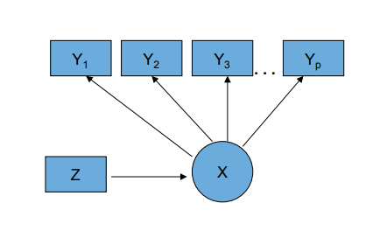
The Latent Class Model
Observed Categorical Items (Y’s)
Categorical Latent Class Variable (C)
Continuous or Categorical Covariates (Z)
C
Notes:
Note: the only difference between the Latent Class and Latent Profile models is that the profile models have continuous Y’s and we are not estimating conditional class probabilities we are estimating conditional means of continuous variables

Slide 6
Note: Many types of latent variable models
Creating typologies based on item responses***
Multilevel latent class models
Longitudinal latent class models
Growth mixture models
Latent transition (“Hidden Markov”) models
Combinations of the above
E.g., Multilevel latent transition model

Slide 7
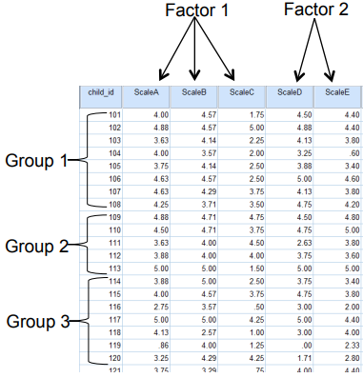
Person-centered v. Variable-centered analysis
LCA is a person-centered approach
Variable centered
Correlations/covariances are of interest
Structure among columns (e.g., factor)
Person centered
Structure among rows is of interest
Seeks to group individuals based on shared characteristics
Goal: identify qualitatively distinct groups

Slide 8
Mixture Models
Latent Class Analysis (LCA) and Latent Profile Analysis (LPA) are special cases of mixture models.
Used to model a “mixture” of unobserved subgroups within a population
Assumes a finite number of latent (hidden) classes that represent qualitatively distinct subgroups
Key Assumptions:
The population is composed of heterogeneous individuals grouped into a finite set of homogeneous categories
Individuals within each class respond similarly (i.e., response patterns are consistent within class)
Class membership is not directly observed, but inferred from patterns in the data
Research Question: Can we identify distinct subgroups of individuals who share similar response patterns or profiles across certain characteristics (e.g., ACEs)?
Notes:
In statistics, a mixture model is a probabilistic model for representing the presence of subpopulations within an overall population, without requiring that an observed data set should identify the sub-population to which an individual observation belongs.

Slide 9
Item | Class 1: Family member illness and death N = 858 (16.31%) | Class 2: Multiple overlapping adversity N = 275 (5.23%) | Class 3: Financial insecurity N = 591 (11.22%) | Class 4: Residential Instability and Family Conflict N = 455 (8.65%) | Class 5: Low Material Hardship N = 3083 (58.59%)
Family Member Hospitalized | 0.782 | 0.62 | 0.172 | 0.14 | 0.092
Divorce or Separation | 0.042 | 0.371 | 0.041 | 0.286 | 0.009
Moved to a different address | 0.434 | 0.812 | 0.504 | 0.526 | 0.281
Partner Lost Job | 0.044 | 0.567 | 0.389 | 0.075 | 0.013
Lost Job | 0.027 | 0.571 | 0.272 | 0.127 | 0.018
Work hours or pay cut | 0.103 | 0.579 | 0.706 | 0.027 | 0.036
Problems paying rent or mortgage | 0.083 | 0.849 | 0.506 | 0.343 | 0.026
Partner away | 0.08 | 0.1 | 0.054 | 0.086 | 0.039
Partner arguments | 0.163 | 0.718 | 0.356 | 0.736 | 0.069
Partner did not want pregnancy | 0.045 | 0.269 | 0.05 | 0.318 | 0.009
Someone close had a drug or alcohol problem | 0.199 | 0.6 | 0.091 | 0.332 | 0.025
Experienced homelessness | 0.001 | 0.296 | 0.017 | 0.034 | 0.002
Close person died | 0.703 | 0.575 | 0.105 | 0.103 | 0.055

Slide 10
Two key model assumptions
Mixture Assumption
There exists a latent categorical variable (unobserved)
This variable defines a finite number of subgroups or classes within the population
Each individual belongs to one and only one class
Classes are qualitatively distinct types, not just points along a continuum
Local Independence Assumption
Within each class, the observed variables (e.g., survey items) are statistically independent
That is, once class membership is accounted for, item responses are uncorrelated
Implies that all associations among observed variables are explained by the latent class structure

Slide 11
Example
If we run an LCA on these indicators of PTSD, what does the mixture assumption imply?
Hypervigilance
Inability to sleep
Nightmares
Avoidance of people
Avoidance of places
Difficulty concentrating
Assume that these two variables ‘load’ on the same latent variable: avoidance of people and avoidance of places? What does the local independence assumption mean?

Slide 12
Outputs and parameters
Parameters used to characterize latent classes
Class prevalence
Probability of endorsing each item within each class
The patterning of the probabilities will suggest that the classes either differ by degree or by substance

Slide 13
Motivating Example: Class differences by degree
Different types of victimization, psychological and psychosocial risk factors are often co-occurring
The Frailty construct in aging research
Latent: degree of frailty meaning how frail on older person is on multiple items
Manifest: criteria (as derived from the literature)
Weight loss above threshold
Low energy expenditure
Low walking speed
Weakness beyond threshold
Exhaustion
RQ?

Slide 14
Bandeen-Roche et al. (2006)
Criterion/Item | 3-Class Model of Frailty
 | Class 1 | Class 2 | Class 3
Weight Loss | .072 | .11 | .54
Weakness | .029 | .26 | .77
Slowness | .004 | .45 | .85
Low Physical Activity | .000 | .28 | .70
Exhaustion | .027 | .16 | .56
Class prevalence (%) | 39.2 | 53.6 | 7.2
Low
Medium
High
The items are no longer correlated w/in each class i.e.,
they are conditionally independent
The latent class accounts for the observed interrelationships
How would you interpret and label these classes?
Notes:
These researchers found 3 classes best described the frailty concept
Of note is that these classes differ by degree – high medium and low

Slide 15
Response Patterns in Latent Class Models
Each item is coded as 1 = Yes and 2 = No
Question: How many possible combinations of the responses are there, and what are they?
Model Concept:
Latent class models estimate the probability of each unique response pattern across the set of observed items.
For example, if there are 3 items, the model estimates the probability of observing each combination:
(Yes, Yes, Yes) → 𝑃₁
(Yes, No, Yes) → 𝑃₂
(No, Yes, No) → 𝑃₃
… up to 2³ = 8 possible patterns
Each combination represents a unique way someone might respond across the items, and the model provides the probability of each pattern occurring in the population.

Slide 16
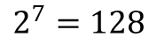
How many patterns?
2
2
2
2
2
2
2
$$2^{7}=128$$
possible response patterns

Slide 17
Evaluating Model Fit
We often use model fit criteria to decide how many latent classes best represent the data.
Model Comparison: Balancing Fit and Parsimony
Better fit means the model describes the data well
Parsimony means the model is simple and avoids unnecessary complexity
We want the best-fitting model that isn’t overly complex
Common Fit Criteria:
AIC (Akaike Information Criterion)
BIC (Bayesian Information Criterion)
Lower values = better balance between fit and simplicity

Slide 18
Relative Model Fit
 | L2 | BIC | AIC | df | P-value
1-C
2-C
3-C
4-C
5-C
6-C
Note: Can make elbow plot of AIC/BIC etc to show lowest value
Notes:
Note: the SPSS module does not give us all of these numbers, but it gives the most important ones

Slide 19
Example: ACEs

Slide 20
The Sum Score, “ACE” Score or Cumulative Risk Score (“CR”)
The co-occurring nature of ACEs has led to the use of an “ACE score,” which represents the total number of ACE categories designed to measure CR
The ACE score (i.e., CR approach) has vastly improved our knowledge about the pervasive and detrimental effects of multiple forms of early childhood adversity
Negative sequelae of cumulative ACE burden (40 + years)
Depression (Chapman, Dube, & Anda, 2007)
Alcohol abuse (Dube et al., 2001)
HIV risk-taking behavior (Bensley, Van Eenwyk, & Simmons, 2000)

Slide 21
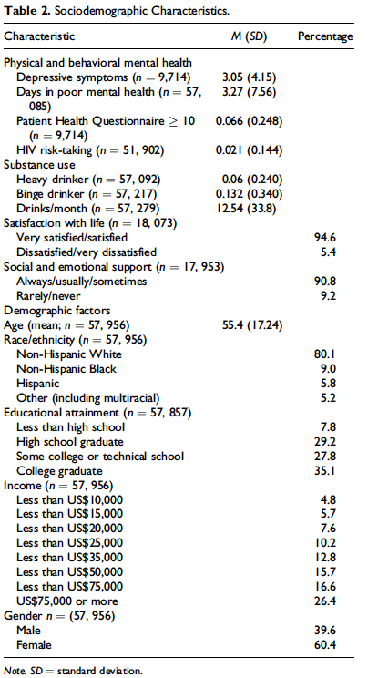
Sample Characteristics of the BRFSS
The sample is predominantly white, highly educated, wealthy and majority female
Should we think about group invariance?
Notes:
On average, respondents were 55.4 years old, tended to be satisfied with their lives, have high levels of emotional and social support and predominantly white, highly educated, wealthy and majority female.
The representativeness of this sample is obviously limited by these characteristics …

Slide 22
Methodological Limitations of the ACE Sum Score
Additivity
Multiplicity
Does 2 + 2 = 4 or 5?
Is 3 > 4 or 4 > 3?
Does marginal cost = 0?
Does “2” = “2”
Does the risk of 1 ACE depend on the risk of another?
Which of the 2^{x} permutations are children experiencing and in what ways does it matter in the long-term? → the LCA question!

Slide 23
Adverse Child Experiences and the Multiple Contexts of Child Development: Justifying a Latent Class Analysis
Relational/Family (e.g., Parental Support
Individual (e.g., Age, Gender)
Society
Community (e.g., Neighborhood Resources)
Reciprocal interactions between developing child and her environment
Any one risk factor has limited explanatory power over the identification of ‘constellations of risk’
The processes undergirding CR are conditional on the pattern of interactions between the child and the broader environment in which he or she exists.
Principles of multi- and equ- finality
Sociological Model of ACEs

Slide 24
Rethinking ACEs: Typologies of Adversity Using Latent Class Analysis (“LCA”)
LCA
Identifies homogenous population subgroups with similar constellations of ACE risk rather than relying on a priori cut points of CR
Allows for the interpretation of nonadditive and higher order interactions among risk factors
Does not treat risk factors as interchangeable, and
Provides new insights into the multiplicative effects of risks at different ecological levels

Slide 25

RESEARCH GOALS
How do the ACEs group together and how many groups can be identified?
Are there differences in CR across groupings of ACEs?
Do the groups differentially predict behavioral and mental health outcomes in adulthood?

Slide 26
Sample Characteristics of the BRFSS
The sample is predominantly white, highly educated, wealthy and majority female

Slide 27
ACES
BRFSS Adverse Childhood Experience (ACE) Module All questions refer to the time period before you were 18 years of age.
Question Wording | n (%) | Response | Coding
Did you live with anyone who
1. was depressed, mentally ill, or suicidal? | 57,437 (15.7) | 1=Yes 2=No 7=DK/NS 9=Refused | 0 = No 1 = Yes 7, 9 = missing
2. was a problem drinker or alcoholic? | 57,646 (23.6)
3. abused prescription medications? | 57,665 (7.7)
4. served time or was sentenced to serve time in a prison, jail, or other correctional facility? | 57,788 (4.9)
5. Were your parents never married, separated or divorced? | 57,219 (21.0) | 1=Yes 2=No 8=Parents not married 7=DK/NS 9=Refused | 1 = divorced, separated, never married 0 = not divorced, separated or married
How often did your parents or adults in your home ever: |  | 1=Never 2=Once 3=More than once 7=DK/NS 9=Refused | 0 = never 1 = one or more times
6. slap, hit, kick, punch or beat each other up? | 57,019 (14.9)
7. hit, beat, kick, or physically hurt you in any way? Do not include spanking | 57,468 (15.3)
8. swore at you, insulted you, or put you down? | 57,103 (31.5)
How often did anyone at least 5 years older than you or an
9. adult, ever touch you sexually? | 57,272 (10.3)
10. try to make you touch them sexually? | 57,320 (7.1)
11. force you to have sex? | 57,329 (4.0)

Slide 28
Multiple Exposure and Cumulative Impact
ACE Category | NONE | ≥1 | ≥2 | ≥3 | ≥4 | ≥5
Child Victimization
Emotional | 25 | 75 | 53 | 36 | 22 | 14
Physical | 9 | 91 | 75 | 58 | 41 | 27
Sexual Touching (Youth to adult) | 11 | 89 | 71 | 55 | 40 | 29
Sexual Touching (Adult to youth) | 4 | 96 | 80 | 63 | 48 | 37
Forced Intercourse | 3 | 97 | 92 | 78 | 65 | 50
Household Traumas
Parental Divorce/Separation | 29 | 71 | 53 | 38 | 26 | 17
Alcohol Abuse | 28 | 72 | 49 | 33 | 21 | 13
Drug Abuse | 9 | 91 | 75 | 57 | 42 | 30
Mental illness | 20 | 80 | 59 | 41 | 28 | 18
Domestic Violence | 10 | 90 | 73 | 55 | 38 | 25
Parental Incarceration | 13 | 87 | 74 | 59 | 46 | 30

Slide 29
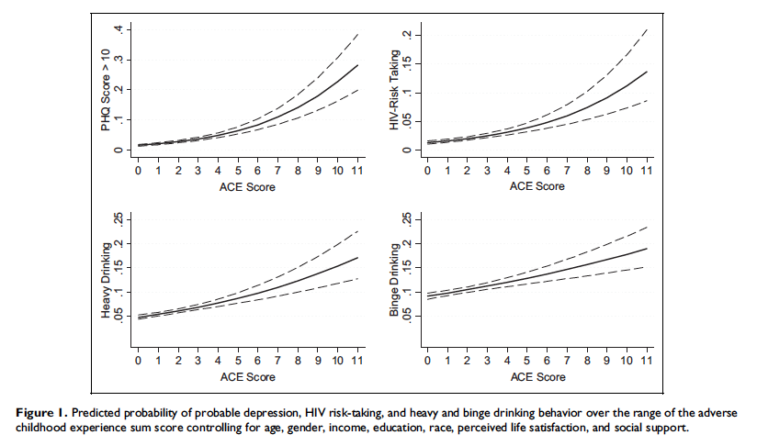
Notes:
This plot shows the sum score on the x-axis and different outcomes on the y-axis including PHQ score which is a measure of depressive symptoms, HIV risk taking behavior such as sharing needles and not wearing a condom, and problem drinking.
In all cases, as ACE score increases, the probability of endorsing these negative behaviors increases as well.
For example, the probability of a PHQ score greater than 10 (clinically relevant depression) is around .3 for respondents with 11 ACEs.
In contrast, individuals with no ACEs have a 0 probability of a PHQ score greater than 10.

Slide 30
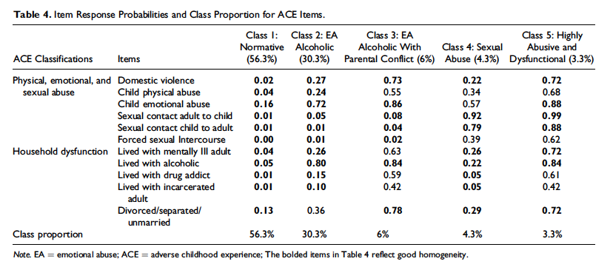

Slide 31
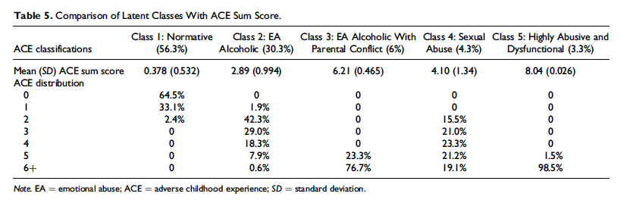
The takeaway here is that individuals in each class have different distributions of sum scores and within each of the types of household the number of ACEs that people experience is quite variable. Youth with a sum score of 5 for example, are equally likely to be in class 3 or class 4 but have not had the same experiences growing up
Notes:
Here we have the Latent Classes compared to the ACE sum score.
Focusing on the first row, we see that the 56.3% of youth in the low adversity, or normative class, have less than 1 ACE on average.
The 30.3% of youth living in the emotionally abusive alcoholic class have about 2.89 ACEs on average, etc.
The chart also shows the ACE distribution for each class.
Focusing on the columns we see that 64.5% of youth in the normative class have no ACEs whereas 33.1% have 1 and 2.4% have 2.
None of the youth in the low adversity class have 3 or more ACEs.
The takeaway here is that individuals in each class have different distributions of sum scores and within each of the types of household the number of ACEs that people experience is quite variable. Youth with a sum score of 5 for example, are equally likely to be in class 3 or class 4, but have not had nearly the same experiences growing up.

Slide 32
Your turn: ACEs
The National Survey of Children’s Health (NSCH.sav) provides rich data on multiple, intersecting aspects of children’s lives—including physical and mental health, access to quality health care, and the child’s family, neighborhood, school, and social context. The National Survey of Children's Health is funded and directed by the Health Resources and Services Administration (HRSA) Maternal and Child Health Bureau (MCHB). A revised version of the survey was conducted as a mail and web-based survey by the Census Bureau in 2016, 2017, 2018, 2019 and 2020. Among other changes, the 2016 National Survey of Children’s Health started integrating two surveys: the previous NSCH and the National Survey of Children with Special Health Care Needs (NS-CSHCN). See the MCHB website for more information on the 2016, 2017, 2018, 2019 and 2020 National Survey of Children's Health administration, methodology, survey content, and data availability.
National Survey of Children's Health - Data Resource Center for Child and Adolescent Health (childhealthdata.org)

Slide 33
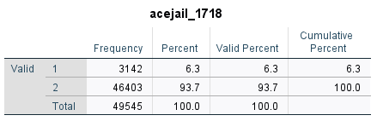
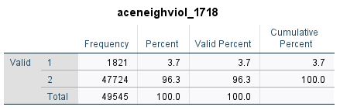
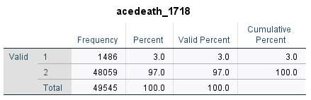
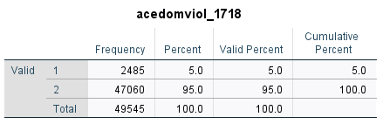

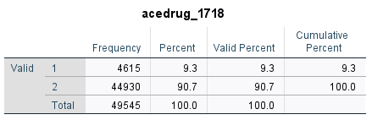
Frequencies
Most commonly endorsed ACE is drug use, then mental health, jail, domestic violence, neighborhood violence and death of parent

Slide 34
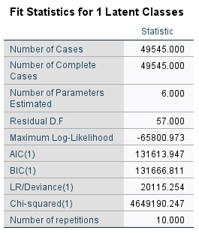
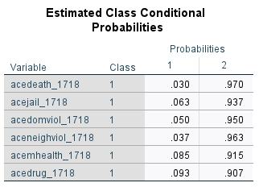
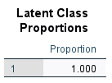
Fit Stats – 1C model
Notes:
NOTE: these are the same as the descriptive stats for each variable…

Slide 35
Warning
Every time you run the model the classes are randomized and so its possible that the classes will be in a different order on subsequent runs
The results will be the same
Pay attention to the order of classes when you run your models

Slide 36
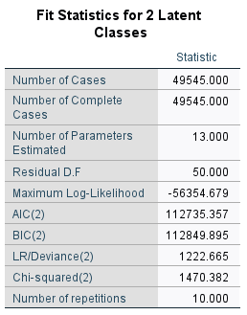
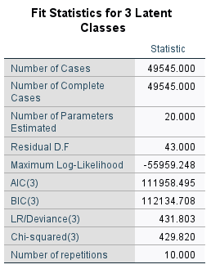

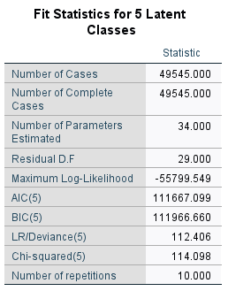


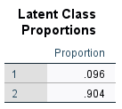
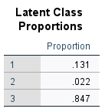
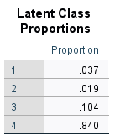
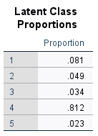
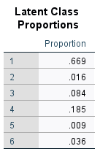
Fit Stats 2C – c-Class Models

Slide 37
Elbow Plot
Number of Classes | AIC | BIC | Log-Likelihood | Residual DF
2 | 1127335 | 112849.9 | -653547 | 50
3 | 1115958 | 112134.7 | -559599 | 43
4 | 1111748 | 111986 | -55847.1 | 36
5 | 1111667 | 111966.7 | -55799.5 | 29
6 | 1111624 | 111985.5 | -55771.2 | 22
7 | 111631.5 | 112054.4 | -55767.8 | 15
You have to make your own elbow plot ☹

Slide 38
Based on the AIC and BIC values in the table:
AIC decreases steadily from the 2-class to the 6-class model, with the lowest AIC at the 6-class model (1,111,624.31).
BIC reaches its lowest value at the 5-class model (1,119,66.66) and then increases again for the 6- and 7-class models.
Model Selection Guidance:
AIC favors the model with the best fit, even if it’s more complex.
BIC is more conservative—it penalizes model complexity more strongly and is preferred for determining the most parsimonious model.
Best Fitting Model: 5-Class Model
The 5-class model strikes the best balance between fit and parsimony, with the lowest BIC.
The 6-class model slightly improves AIC, but the BIC increases, and one class has a very small proportion (0.9%), suggesting potential overfitting or an unstable class.
The 7-class model continues this trend with increasing BIC and additional tiny classes.
Conclusion: You should select the 5-class model, as it has the lowest BIC, maintains interpretability, and avoids very small class sizes that may be unreliable.

Slide 39
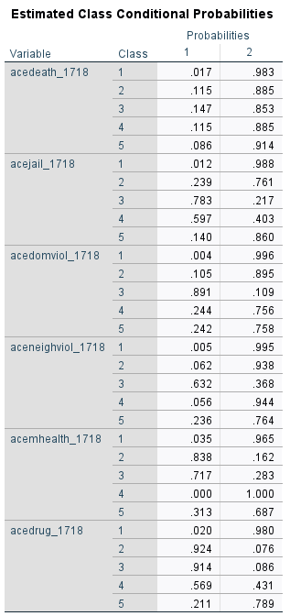
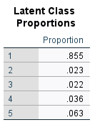
I first went with the 5-Class Model

Slide 40
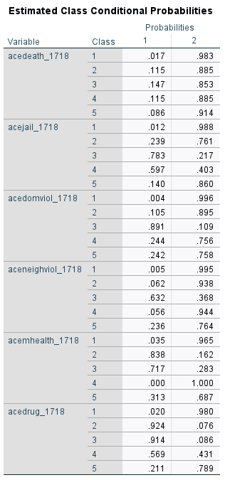
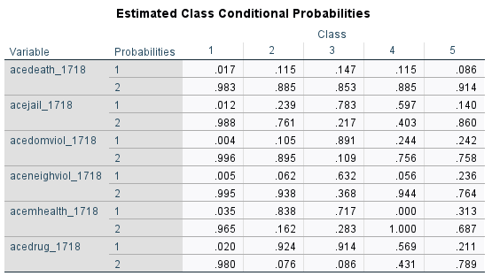
Use Pivot Trays to get appropriate output

Slide 41
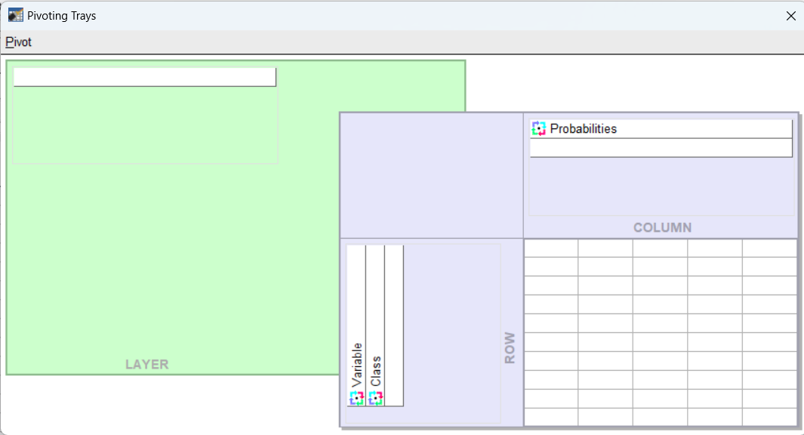
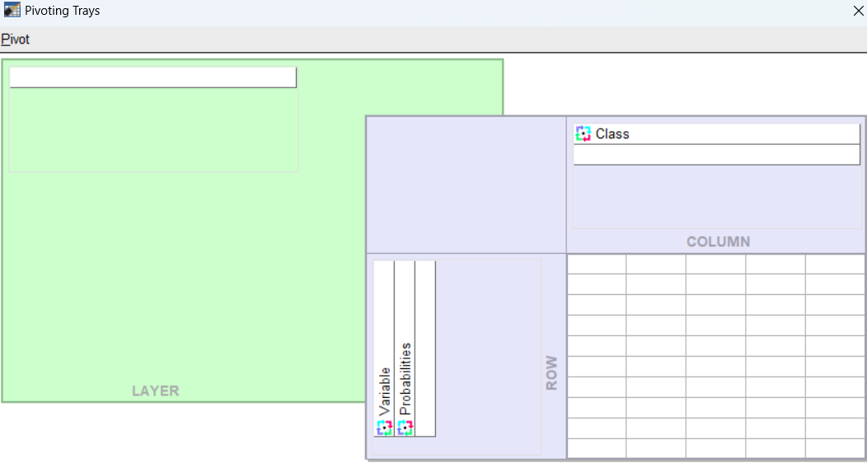

Slide 42
 |  | Class 1 | Class 2 | Class 3 | Class 4 | Class 5
Death of Parent | Yes | 0.017 | 0.115 | 0.147 | 0.115 | 0.086
 | No | 0.983 | 0.885 | 0.853 | 0.885 | 0.914
Jail | Yes | 0.012 | 0.239 | 0.783 | 0.597 | 0.14
 | No | 0.988 | 0.761 | 0.217 | 0.403 | 0.86
Domestic Violence | Yes | 0.004 | 0.105 | 0.891 | 0.244 | 0.242
 | No | 0.996 | 0.895 | 0.109 | 0.756 | 0.758
Neighborhood Violence | Yes | 0.005 | 0.062 | 0.632 | 0.056 | 0.236
 | No | 0.995 | 0.938 | 0.368 | 0.944 | 0.764
Mental Health | Yes | 0.035 | 0.838 | 0.717 | 0 | 0.313
 | No | 0.965 | 0.162 | 0.283 | 1 | 0.687
Drug Use | Yes | 0.02 | 0.924 | 0.914 | 0.569 | 0.211
 | No | 0.98 | 0.076 | 0.086 | 0.431 | 0.789
Class % |  | 85.5 | 2.3 | 2.2 | 3.6 | 6.3
Class 4: Jail/Substance Use with some domestic violence
Class 5: Low Aces
Class 1: No Aces
Class 2: Mental Health/Substance Use
Class 3: High ACEs
Classes are not well separated
Notes:
Note: two classes overlap and can be considered ‘low/no’ Aces and so I went with the four class model before settling on the 3 class model
There is better separation in the 3 class model

Slide 43
 | Class 1 | Class 2 | Class 3 | Class 4 | Class 5 | High | Low
Death of Parent | 0.017 | 0.115 | 0.147 | 0.115 | 0.086 | 0.8 | 0.2
Jail | 0.012 | 0.239 | 0.783 | 0.597 | 0.14 | 0.8 | 0.2
Domestic Violence | 0.004 | 0.105 | 0.891 | 0.244 | 0.242 | 0.8 | 0.2
Neighborhood Violence | 0.005 | 0.062 | 0.632 | 0.056 | 0.236 | 0.8 | 0.2
Mental Health | 0.035 | 0.838 | 0.717 | 0 | 0.313 | 0.8 | 0.2
Drug Use | 0.02 | 0.924 | 0.914 | 0.569 | 0.211 | 0.8 | 0.2
Class 1: No Aces
Class 2: Mental Health/Substance Use
Class 3: High ACEs
Class 4: Jail/Substance Use with some domestic violence
Class 5: Low Aces

Slide 44
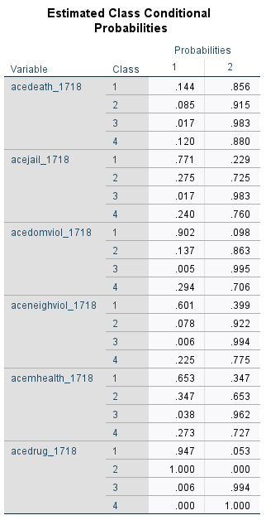
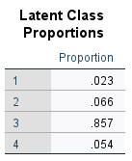

Slide 45
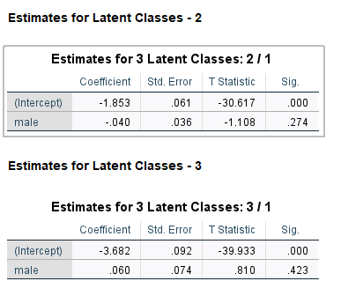
3-Class Model and Gender as covariate
 |  | Class 1 High ACEs 2.2% | Class 2 No ACEs 84.7% | Class 3 Subs Use/Mental Health 13.1%
Death of Parent | Yes | .146 | .017 | .096
Death of Parent | No | .854 | .983 | .904
Jail/Incarceration of Parent | Yes | .787 | .013 | .268
Jail/Incarceration of Parent | No | .213 | .987 | .732
Domestic Violence | Yes | .936 | .007 | .180
Domestic Violence | No | .064 | .993 | .820
Neighborhood Violence | Yes | .629 | .008 | .121
Neighborhood Violence | No | .371 | .992 | .879
Mental Health | Yes | .664 | .032 | .329
 | No | .336 | .968 | .671
Substance Use | Yes | .876 | .008 | .514
 | No | .124 | .992 | .486
Notes:
IF YOU ARE CONFUSED REMEMBER THAT WITHIN THE CLASS, EACH VARIABLE RESPONSE PROBABILITIES MUST SUM TO 1

Slide 46

Prediction
We are interested in how the covariate predicts membership in a latent class

Slide 47

Adding covariates
Now we can include covariates to predict membership in each latent class
Note: you must choose the latent classes first, before including covariates!
We are predicting membership in a latent class, 1 = in the class, 0 = not in the class → logistic regression

Slide 48

Gender as Predictive of Latent Class Membership
We have gender as a covariate
We are predicting whether females (males) are more likely to be in class
1 v 2
1 v 3
1 v 4
2 v 4
2 v 3
3 v 4
But, the software selects only one class for comparison (class 1)
What do you expect
Recall we have high, low, direct and indirect…
Notes:
The comparison class is the familiar ‘omitted’ class

Slide 49
Logistic regression refresher
Suppose the logistic regression coefficient for being female is –0.3406
This means that the log odds of the outcome (i.e., the dependent variable being “1” or “Yes”) are 0.3406 units lower for females compared to males
To interpret this in terms of odds, we exponentiate the coefficient: exp(−0.3406)=0.71
So, the odds of the outcome are 0.71 times as high for females—or 29% lower—compared to males
To express this as a percentage change in odds:
(exp⁡(−0.3406)−1) × 100= −29%
Being female is associated with a 29% decrease in the odds of the outcome (relative to males), holding other variables constant.

Slide 50
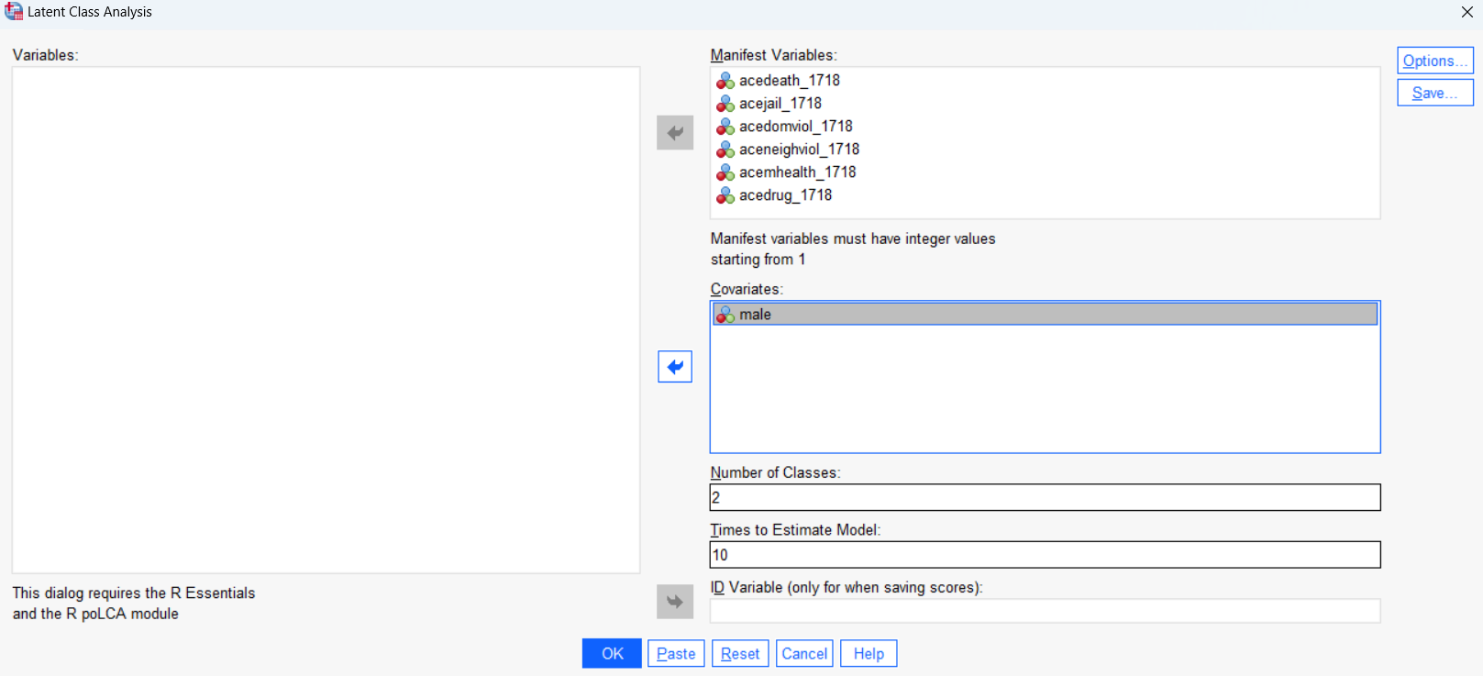
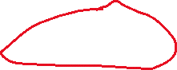

Slide 51
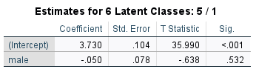
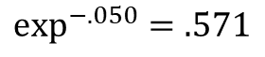
Logistic (Multinomial) Regression Results
Example: Does the distribution of classes differ by sex at birth?
Female is 0/Male is 1
The odds of males being in class 5 versus class 1 are no different
Specifically, the odds of being in class 5 compared to class 1 are .951 times lower for males versus females.
Males are no more likely to be in the ‘No ACEs’ class compared to females.
$$\exp^{−.050}=.571$$

